Slide 1
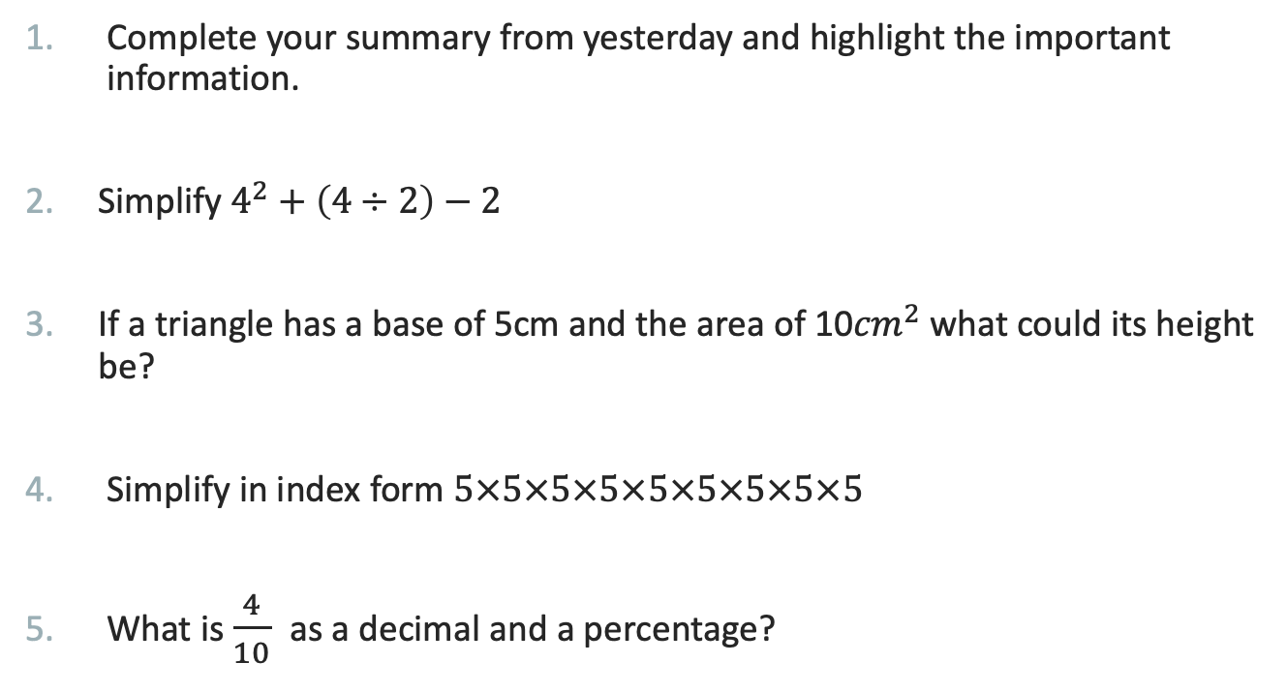
First five Questions
Index Notation
EQ – What are the Index Laws and how do I apply them?
Complete your summary from yesterday and highlight the important information.
Simplify $4^{2}+\left(4÷2\right)−2$
If a triangle has a base of 5cm and the area of 10${cm}^{2}$ what could its height be?
Simplify in index form $5×5×5×5×5×5×5×5×5$
What is $\frac{4}{10}$ as a decimal and a percentage?

Slide 2
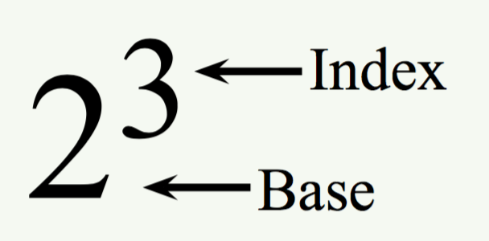
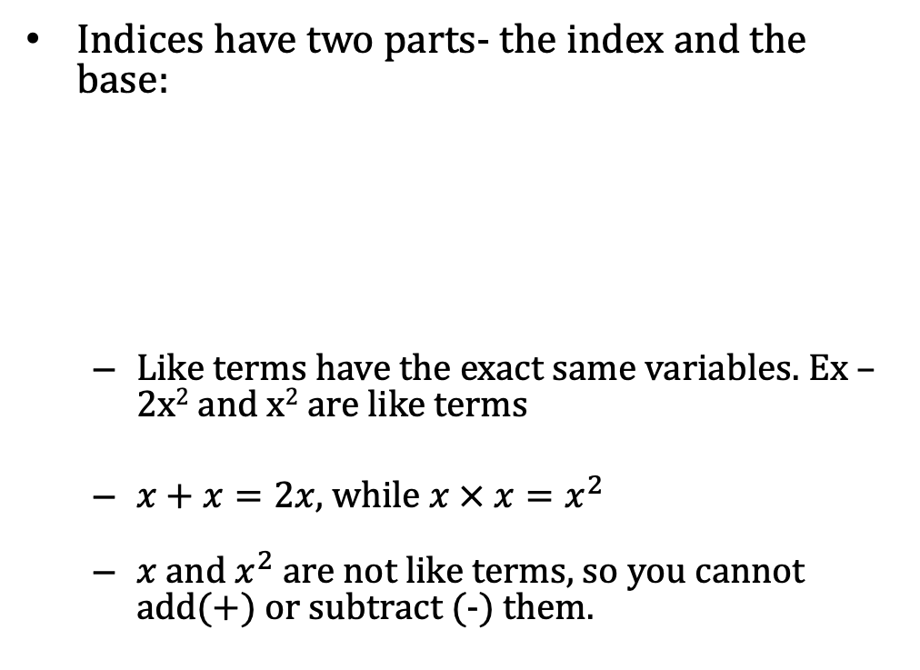
24
7
30
Date
Index Notation
EQ – What are the Index Laws and how do I apply them?
What is an index?
Indices have two parts- the index and the base:
Like terms have the exact same variables. Ex – 2x² and x² are like terms
$x+x=2x$, while $x × x=x^{2}$
$x$ and $x^{2}$ are not like terms, so you cannot add(+) or subtract (-) them.
What is a like term

Slide 3
24
7
30
Date
Index Notation
EQ – What are the Index Laws and how do I apply them?
What is an index?
Indices have two parts- the index and the base:
Like terms have the exact same variables. Ex – 2x² and x² are like terms
$x+x=2x$, while $x × x=x^{2}$
$x$ and $x^{2}$ are not like terms, so you cannot add(+) or subtract (-) them.
What is a like term

Slide 4
24
7
30
Date
Index Notation
EQ – What are the Index Laws and how do I apply them?
What are index laws?
There are laws that govern how we solve problems with indices, these are called index laws.
Multiplication Law : a^{m} x a^{n} = a^{m+n}
When multiplying two indices together, you add them – you can only add like bases
y³ x y⁴
= y³⁺⁴
=y⁷
REMEMBER: if there is and “a” and a “b”, only multiply “a” by “a” and “b” by “b” eg:
a⁴b³ x a²b becomes a⁴ x a² x b³ x b =
= a⁴⁺² x b³⁺¹
⁼ a⁶b⁴
What is the Multiplication law?

Slide 5
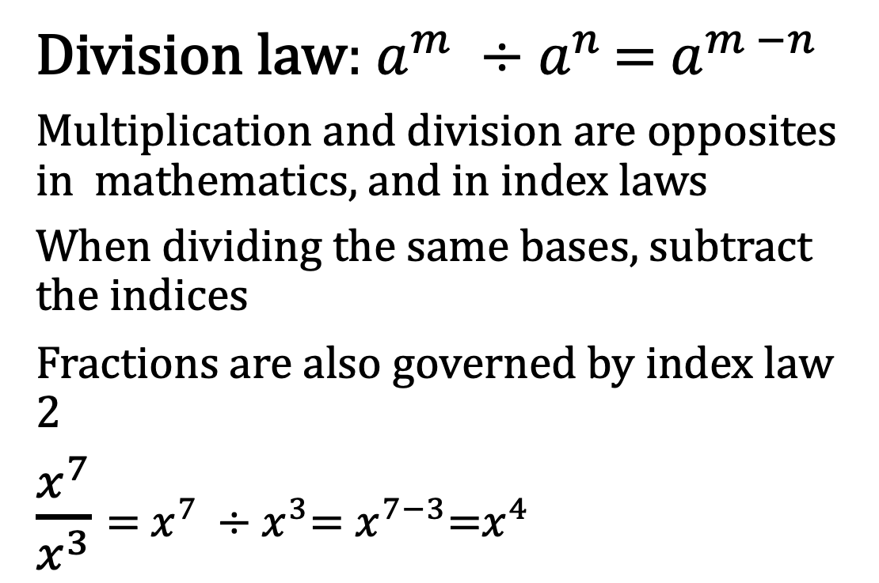
24
7
30
Date
Index Notation
EQ – What are the Index Laws and how do I apply them?
Division law: $a^{m} ÷a^{n }$= $a^{m −n}$
Multiplication and division are opposites in mathematics, and in index laws
When dividing the same bases, subtract the indices
Fractions are also governed by index law 2
$\frac{x^{7}}{x^{3}}$ = $x^{7 }÷x^{3}$= $x^{7−3}$=$x^{4}$
What is the Division law?

Slide 6
24
7
30
Date
Index Notation
EQ – What are the Index Laws and how do I apply them?
Power of a Power: (a^{m})^{n} = a ^{m x n}
When there are indices inside and outside of a brackets, they multiply.
Eg; (x⁴)³ - think about what indices mean. (expand the indices)
(x⁴)³ means (x⁴) x (x⁴) x (x⁴), then use the first index law,
x⁴⁺⁴⁺⁴ ⁼ x¹²
Multiply by the index outside the brackets.
What is the Power of a power law?

Slide 7
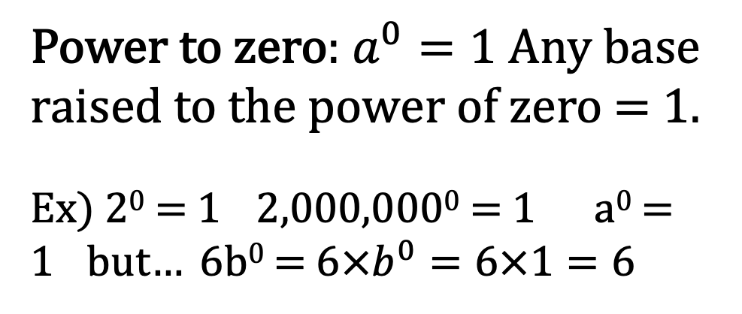
24
7
30
Index Notation
Date
EQ – What are the Index Laws and how do I apply them?
Power to zero: $a^{0}=1$ Any base raised to the power of zero = 1.
Ex) 2⁰ = 1 2,000,000⁰ = 1 a⁰ = 1 but… 6b⁰ = $6×b^{0}=6×1=6$
What is the Power to zero law?

Slide 8
Complete Have Some Fun Worksheet
HAVE ANY QUESTIONS?

Slide 9
Homework
Review your notes and write a summary answering the essential question.

